Slide 1
Karto: Car Maintenance and Gas Finder Application
Owen Kemp, Joshua Quaintance, Joshua Wise, Blake Payne

Slide 2
Purpose
Help keep track of cars.
Keep a history of the maintenances done on each car.
Find gas from gas stations.

Slide 3
MVP
Authenticate users
Add trusted gas stations
Look for gas prices
Maintain a list of cars
Create cars
Maintain a maintenance log on each car

Slide 4
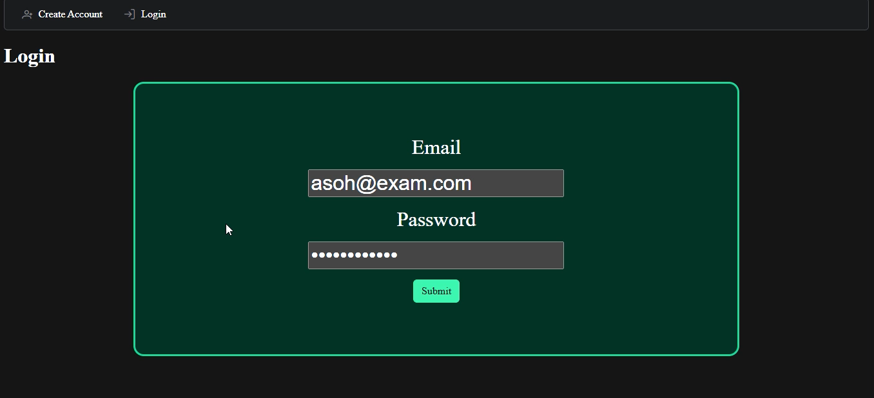
Authenticate User

Slide 5
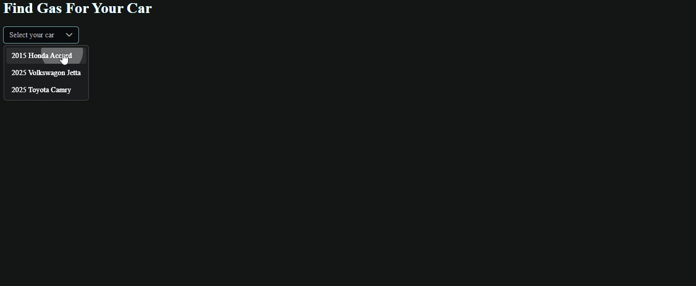
Gas Prices

Slide 6
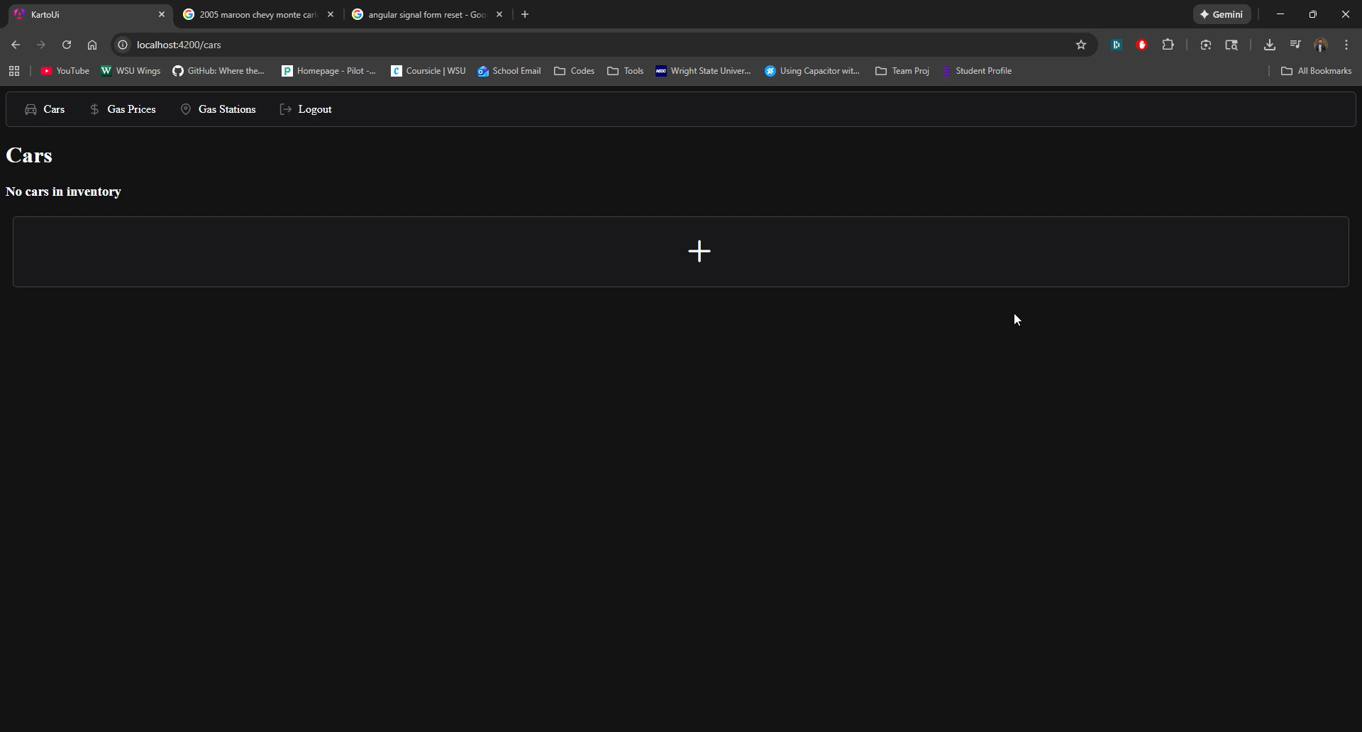
Car List

Slide 7
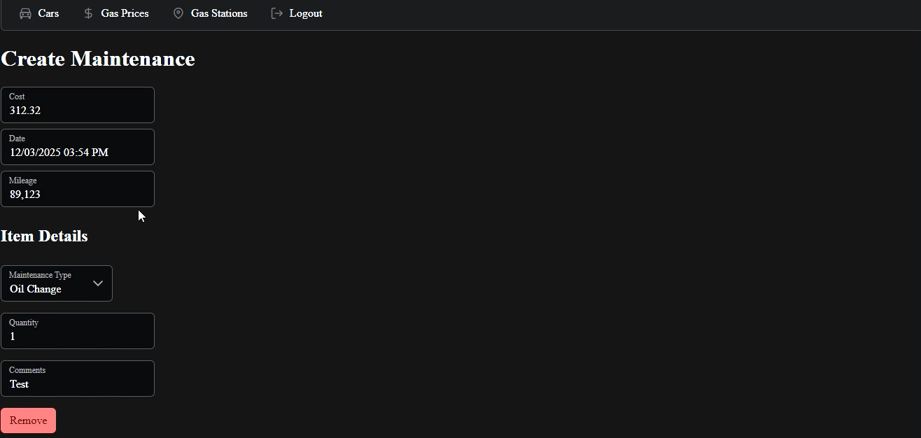
Maintenance List

Slide 8
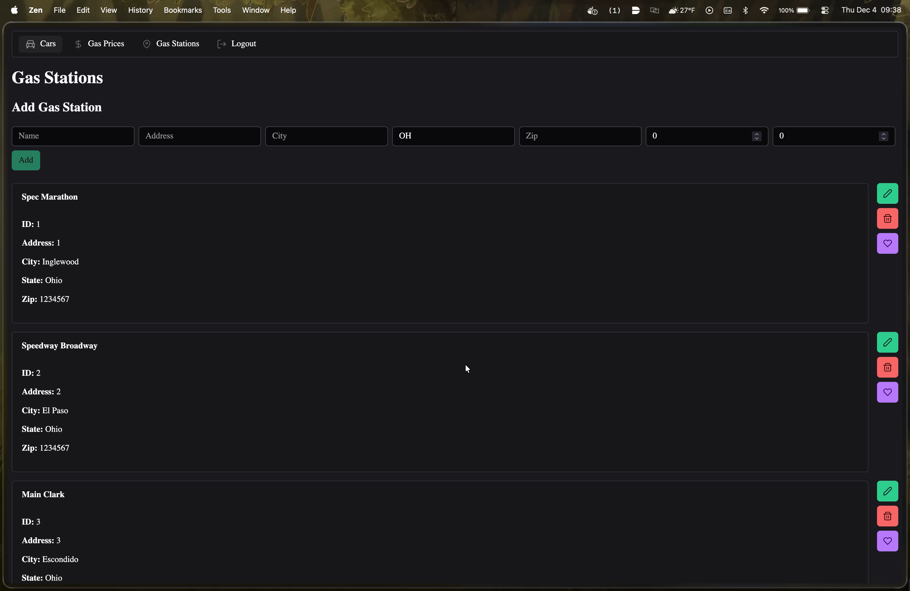
Gas Station List

Slide 9
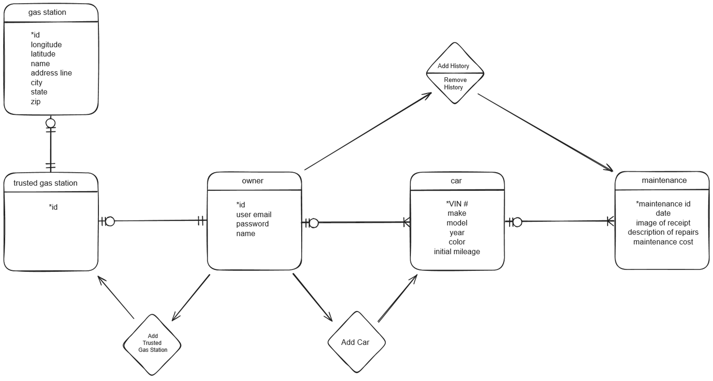
Conceptual Model

Slide 10
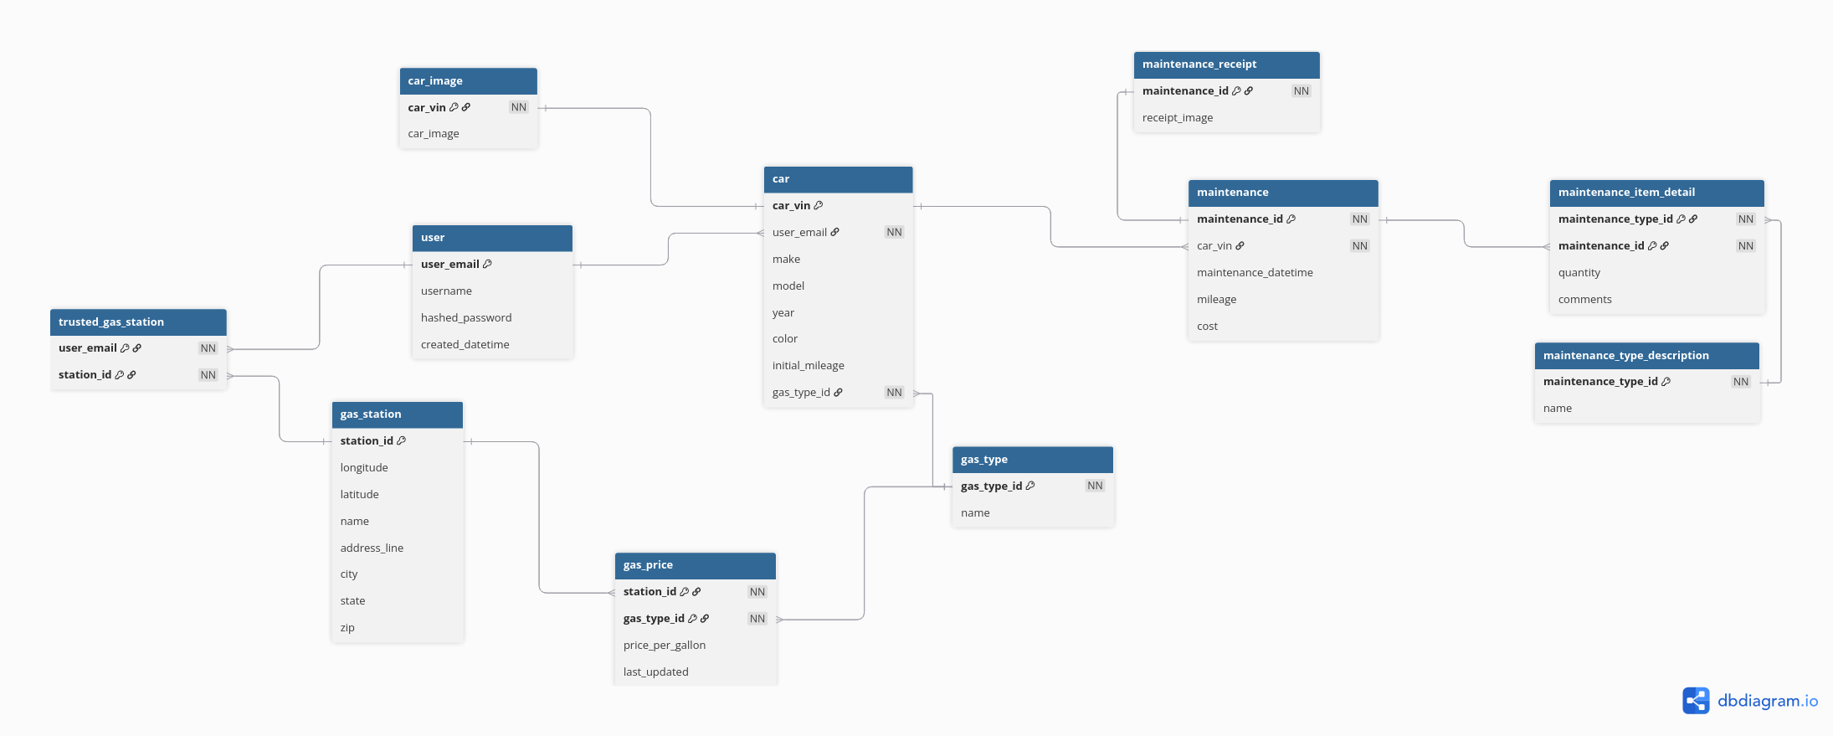
Logical Model

Slide 11
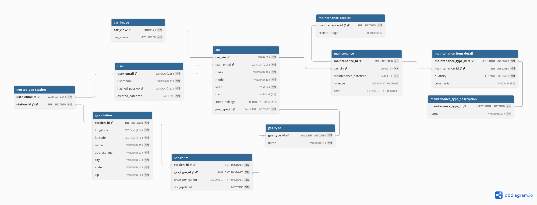
Physical Model

Slide 12
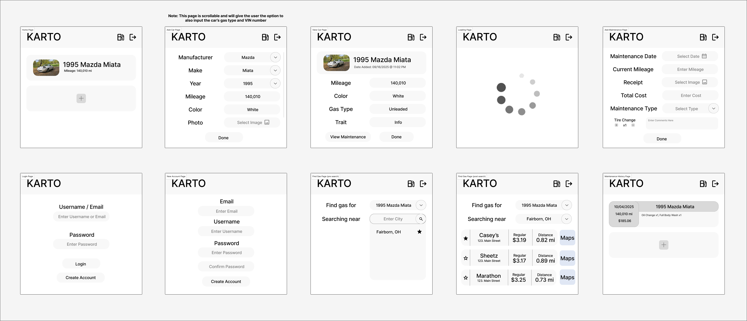
UI - Wireframes

Slide 13

UI – Brand Guide

Slide 14
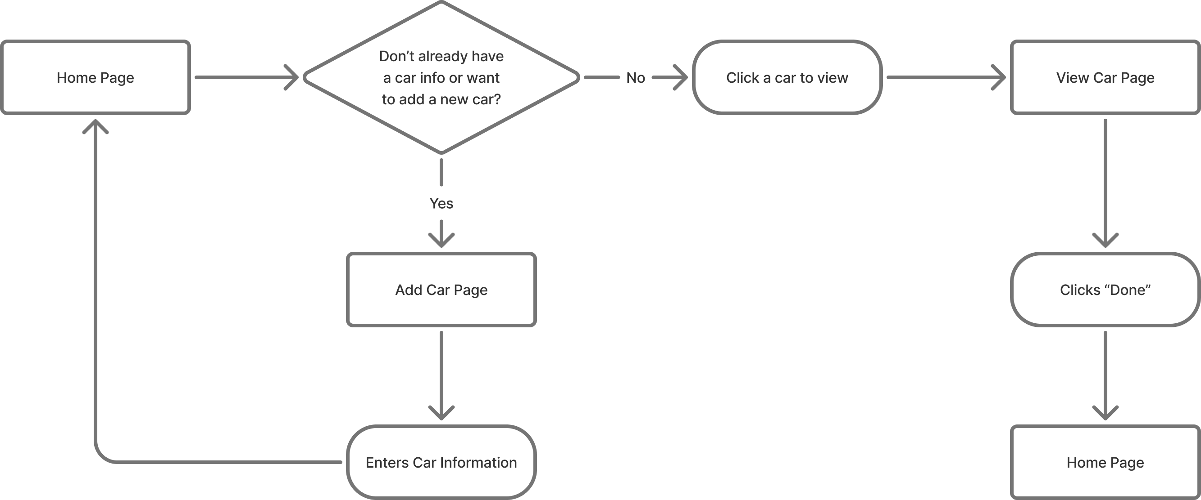
UX – Add Car

Slide 15
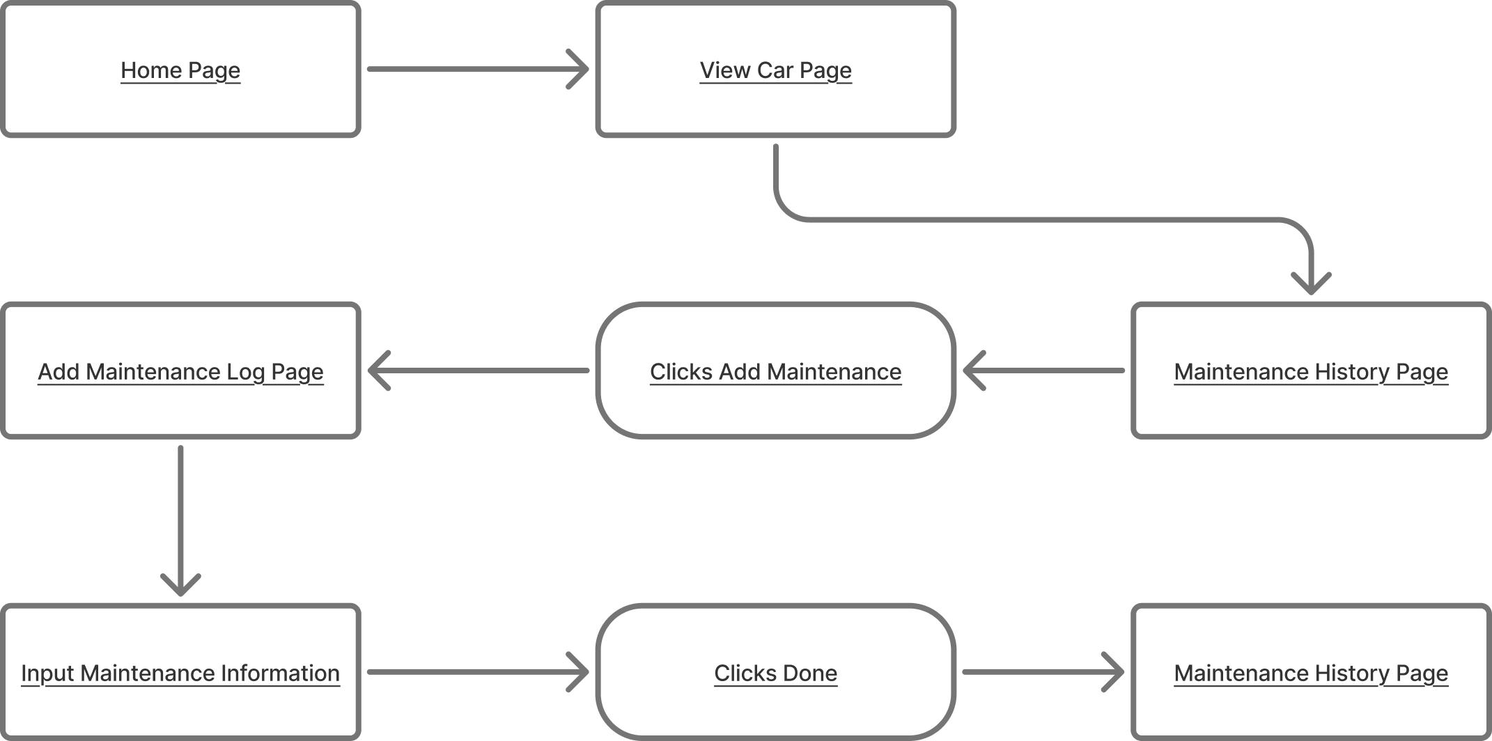
UX – Add Maintenance

Slide 16
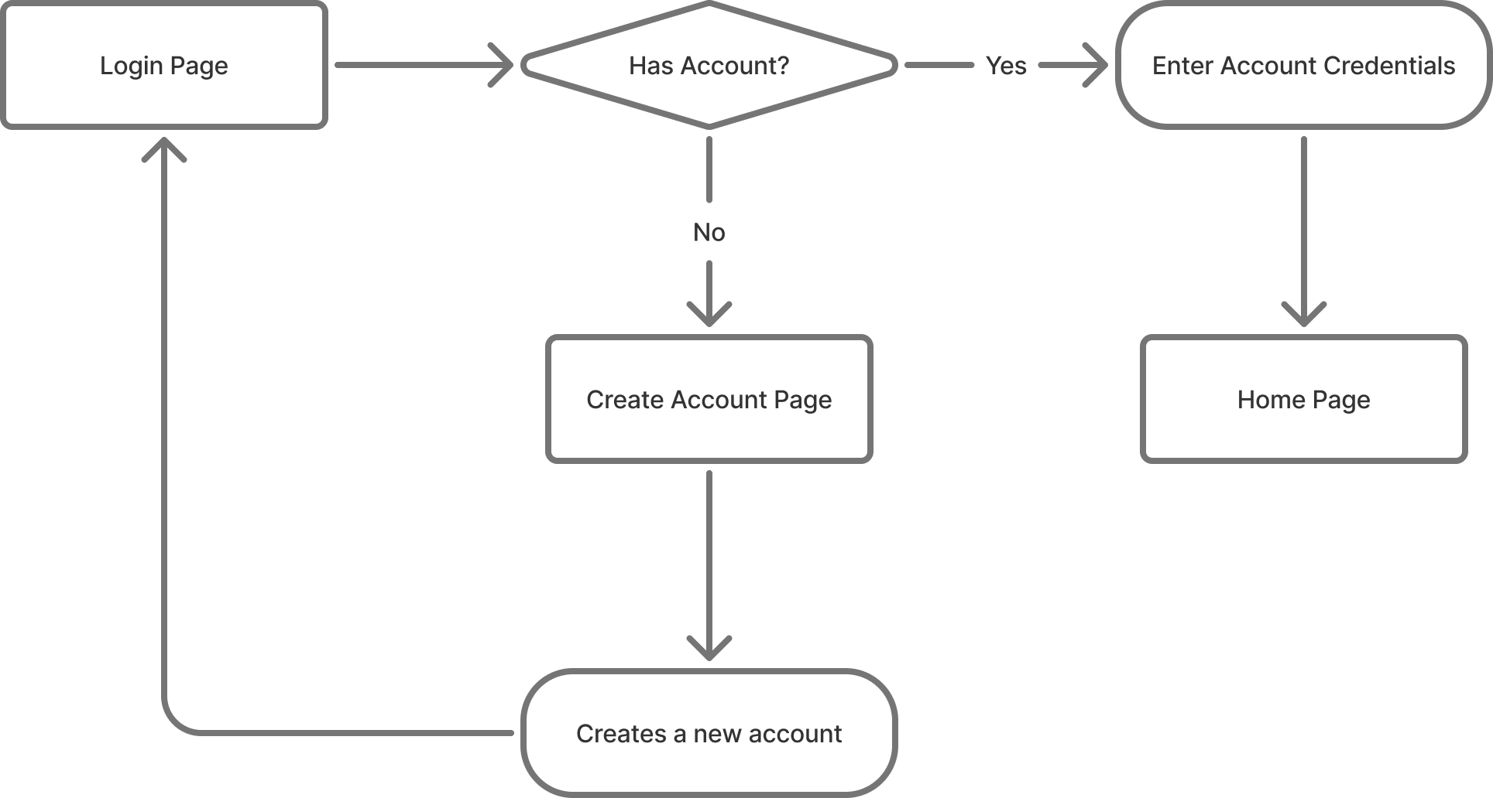
UX – Create Account

Slide 17
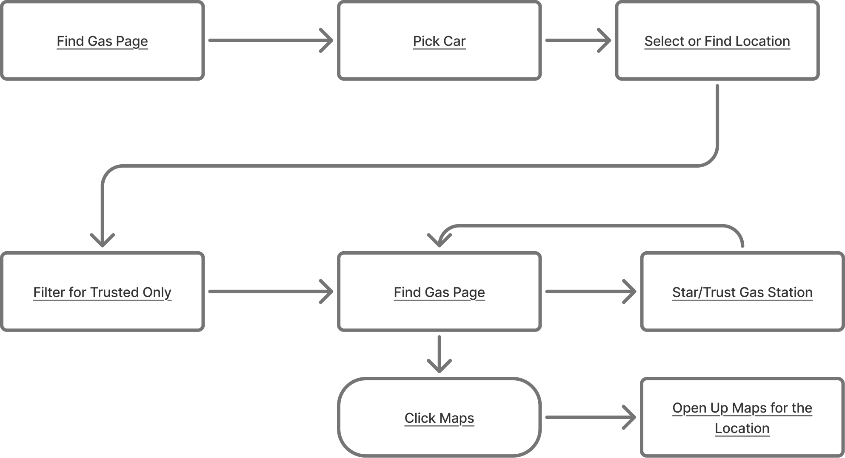
UX – Find Gas

Slide 18
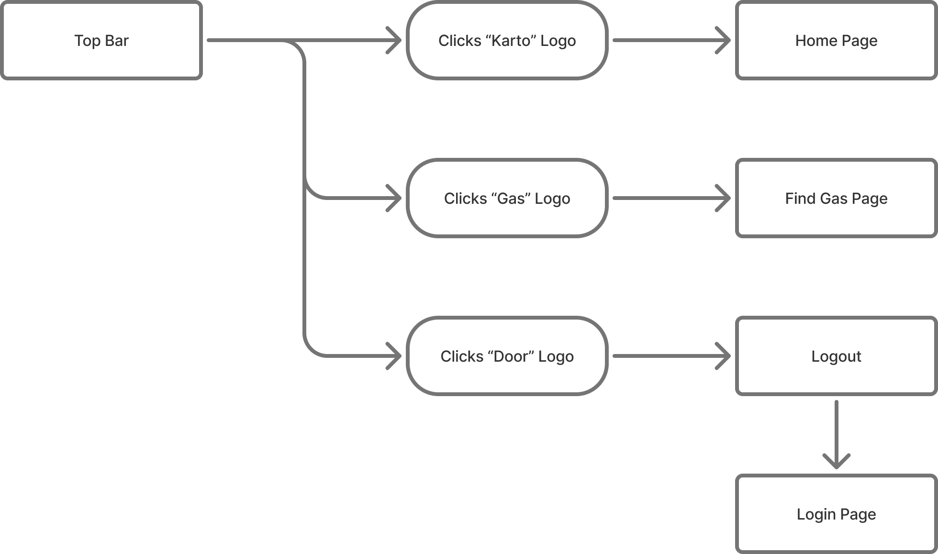
UX – Navigation Bar

Slide 19
API Endpoints
Maintenance
GET - all maintenances
GET - all maintenances by car
GET - maintenance by Id
GET - all maintenance types
GET - maintenance statistics by car
POST - maintenance
PUT – maintenance
DELETE - maintenance
Car
GET - all cars
GET - all cars by owner email
GET - all cars by vin
POST - Create a new car
PUT - Update car details

Slide 20
API Endpoints
Gas Type
GET - all gas types
GET - gas type by id
GET - gas type by name
POST - create new gas type
PUT - Update gas name
User
GET - all users
GET - users by id
GET - users by username
POST - create new users
POST - login with email and password
PUT - update users

Slide 21
API Endpoints
Document: https://github.com/WSU-kduncan/cs4900-api-karto/blob/main/API%20Definitions.md
Gas Station
GET - all gas stations
GET - gas station by id
GET - gas station by name
GET - gas station by trusted
POST - create new gas station
PUT - update gas station

Slide 22
Live Demonstration
Hopefully, nothing goes wrong 😊🙏.
Can join the website with this URL if you are on WSU-Secure.
http://10.17.140.246:4200

Slide 23
Improvements
Better UI
Better Error Handling
Authorization
Update Gas Prices Automatically
Unit and Integration Tests

Slide 24
Questions?

